Slide 1
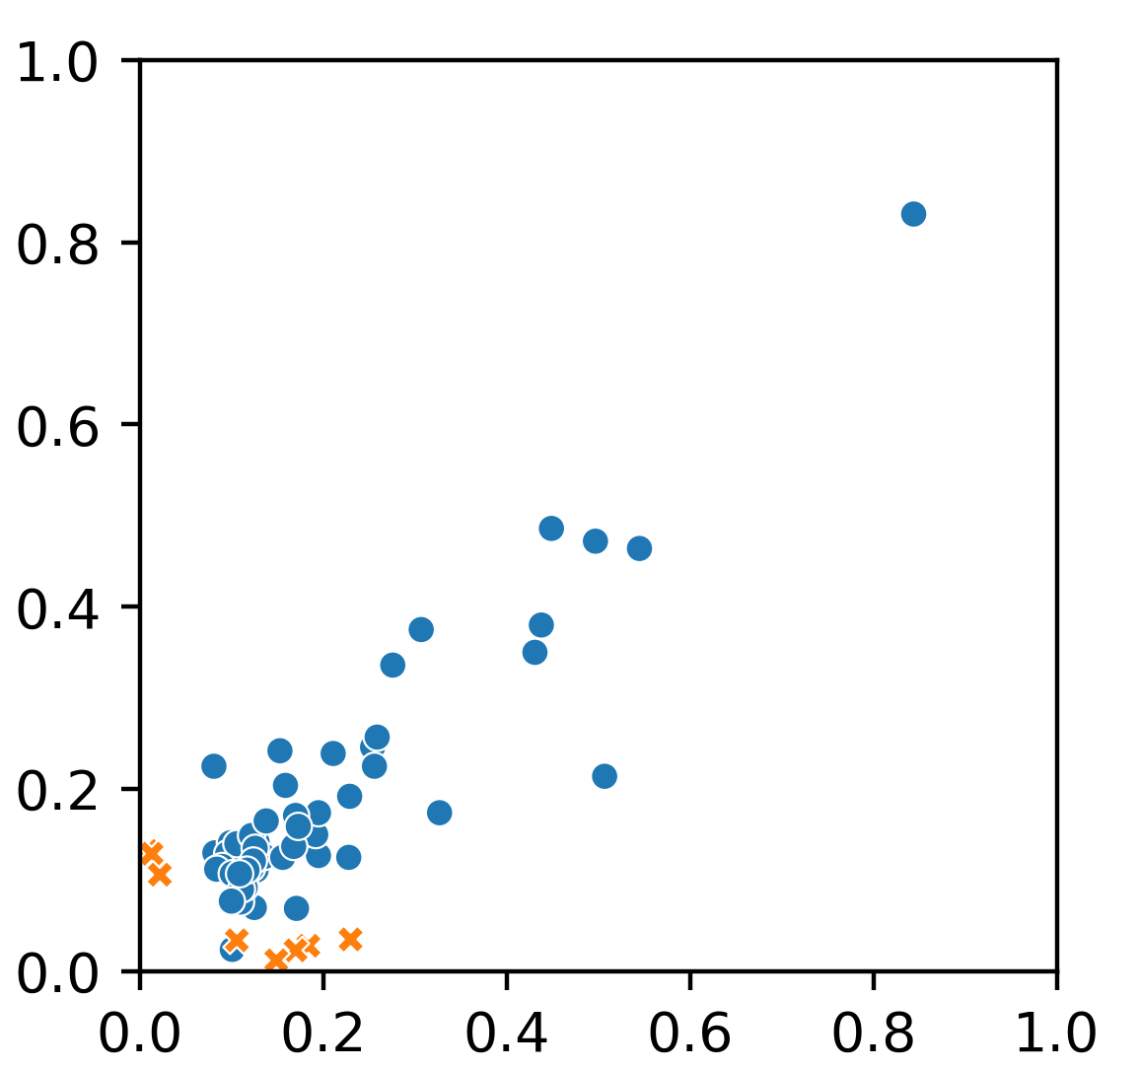
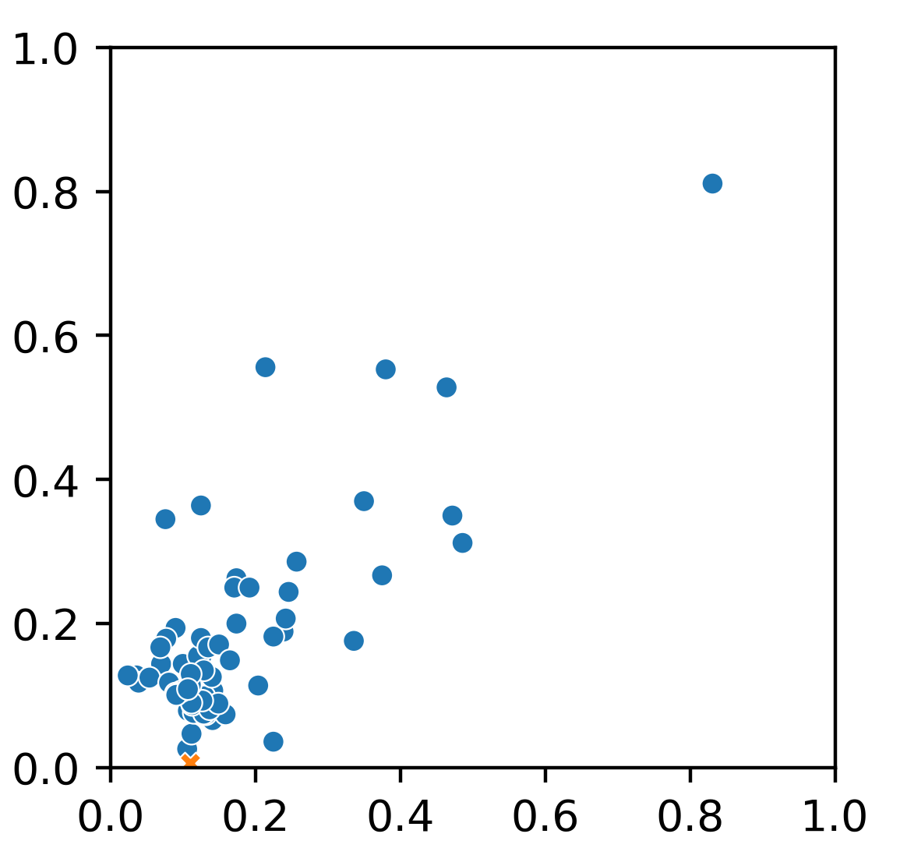
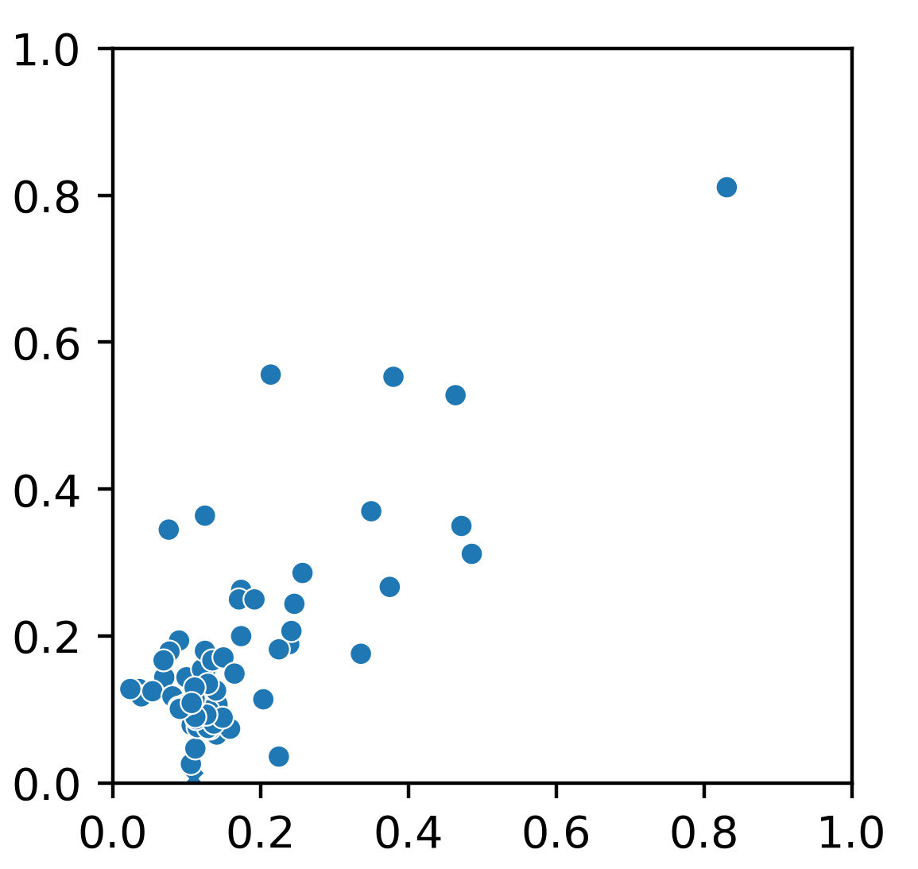
A
MT-B
MT-C
MT-A
6
55
MT-D
3
22
69
1
15
0
68
3
0
6
6
1
B
R = 0.81
R = 0.76
R = 0.79
MT-B
MT-C
MT-D
MT-A
MT-B
MT-C

